Slide 1
The Innovation Lab
How can we adapt the mini-grid business model to:
Increase customers’ ability to pay.
Increase energy consumption.
Turn the mini-grid into a profitable, sustainable business.
10 prototypes investigating affect of changes to the mini-grid business model.
(Appliance financing, tariff reduction, free wifi, and more.)

Slide 2
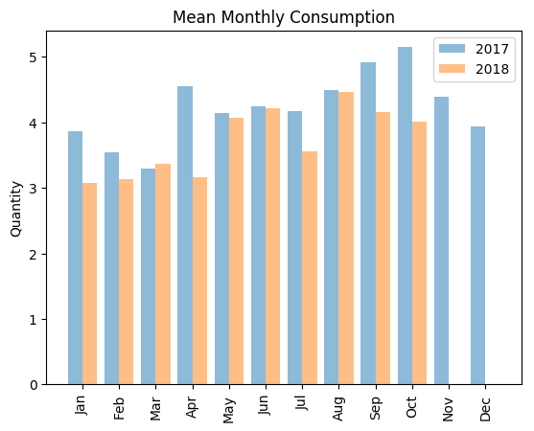
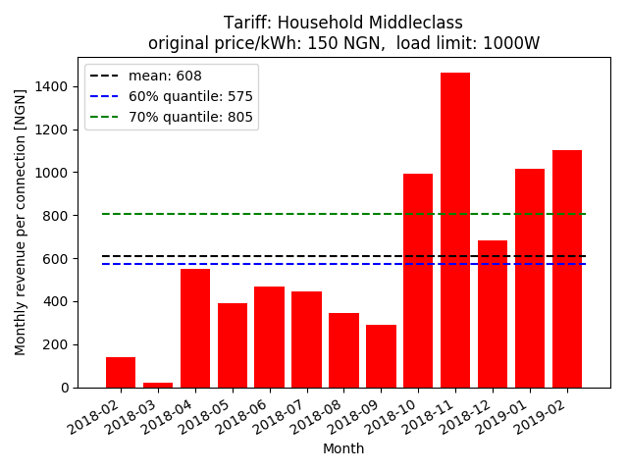
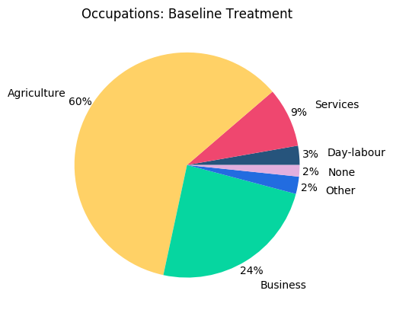
10 million data points
1. Energy consumption
2. Customer payments
3. Socio-economic data
Images: own work, illustrative

Slide 3
Project: Survey Shortening
10 prototypes.
~500-2,000 customers per prototype.
Baseline, midline & endline surveys for each customer.
~10,000 surveys still to be carried out!
Innovation lab had a long survey: 45-60 mins each time.
Project aim: cut down the survey to 15 minutes, saving around 7,500 hours, or 312 days, of interviews.

Slide 4
Methodology
Find the questions that best predict the energy consumption of a customer, and keep those in.
Find questions that are highly corelated, and so are redundant.
Statistics
Machine learning
Image source: Wikimedia
Image source: Towards Data Science

Slide 5
Challenges
I’d hadn’t used the analytical tools, or the programming language since university.
Find help!
Economist/statistician, colleague in E4I
Academic working under the Lab informed the methodology.
Williams, Nathan, Booth, Samuel S, and Baring-Gould, Edward I. (2019).
Messy & missing day
Cleaning
Imputing

Slide 6
Results - correlation
packages: pandas
Correlation coefficients > 0.75
Buying decisions for household tend to be the same for all major expenses.
Income generating activities & Source of income tends to be the same.

Slide 7
Results – LASSO regression
packages: pandas, sklearn
Variable | Coefficient | Direction
Credit_recharge_average | 7.54E-06 | +
Fetching_time_minutes | -1.81E-05 | -
Food | 0.00010478 | +
HH_expenses | 0.00052682 | +
HH_income | 1.38E-05 | +
Recharge_cost | 8.77E-07 | +
Savings | -0.0004529 | -
Indicators of wealth and disposable income:
Income/Expenses
Time taken to fetch water
Mobile airtime

Slide 8
Results – Random Forest Regressor
packages: pandas, sklearn
Variable | Importance
Sleep_time_cos | 0.071
HH_expenses | 0.059
Food | 0.047
Debt | 0.045
Rent | 0.036
Fridge | 0.035
Phone | 0.019
Transportation | 0.018
Years_in_community | 0.016
Age | 0.013
Nr_recharges_per_week | 0.010
Hours_of_cooking_tech_use | 0.009
Education | 0.009
Light_bulbs | 0.009
HH_income | 0.009
Employment_status_2.0 | 0.008
Credit_recharge_average | 0.008
HH_Size | 0.008
Nr_rooms | 0.007
Indicators of wealth and disposable income:
Income/Expenses
Lifestyle & other wealth indicators
Appliance ownership & use
Mobile airtime

Slide 9
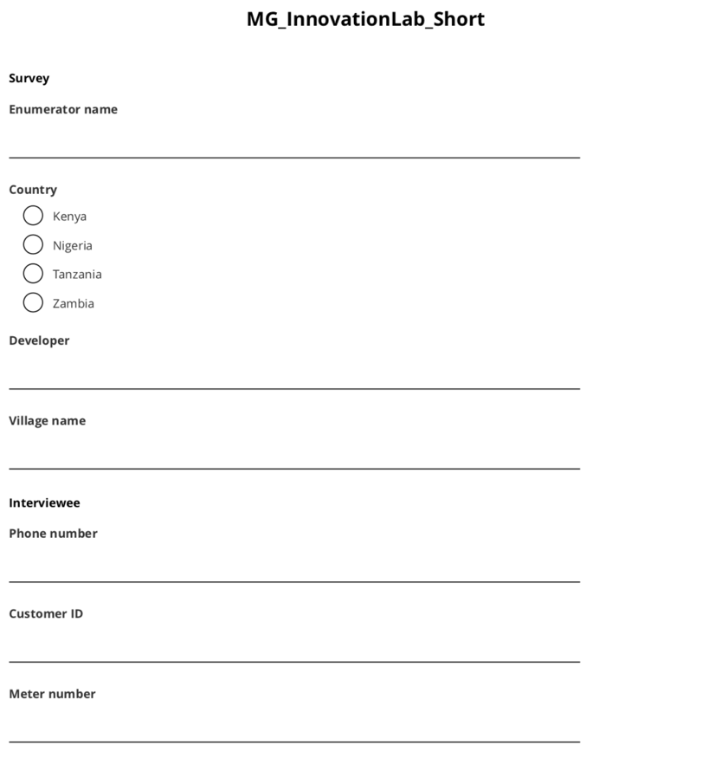
Finished survey
Short and optimised survey.
350 → 65 questions
43 → 8 pages
60 → ~15 minutes
Field testing is underway.

Slide 10
References
Williams, Nathan, Booth, Samuel S, and Baring-Gould, Edward I. (2019). Survey Use in Micro-Grid Load Prediction, Project Development, and Operations: Review and Best Practices. United States: N. p., 2019. https://www.nrel.gov/docs/fy19osti/72339.pdf
ESMAP. (2019). Mini Grids for Half a Billion People : Market Outlook and Handbook for Decision Makers. ESMAP Technical Report;014/19. World Bank, Washington, DC. © World Bank. https://openknowledge.worldbank.org/handle/10986/31926 License: CC BY 3.0 IGO.
Acumen (2019). In Response: Why we believe The Economist should reconsider their doubts regarding the impact of electrification on the poor. https://acumen.org/blog/in-response-why-we-believe-the-economist-should-reconsider-their-doubts-regarding-the-impact-of-electrification-on-the-poor/
AMDA (2018). Mini-Grids on the Trajectory of Rural Electrification in Africa. http://africamda.org/wp-content/uploads/2018/10/WHITE-PAPER-Mini-Grids-on-the-Trajectory- of-Rural-Electrification-in-Africa.pdf
IFC. (2018). Benchmarking Mini-Grid DESCOs 2017 Update. https://www.ifc.org/wps/wcm/connect/87b7df8f-94da-43ed-b168-3099b1edff45/IFC+Mini-grid+DESCO+Benchmarking+2017+Update.pdf?MOD=AJPERES
Booth, S., Li, X., Baring-Gould, I., Kollanyi, D., Bharadwaj, A., & Weston, P. (2018). Productive Use of Energy in African Micro-Grids: Technical and Business Considerations. Energy 4 Impact and NREL. https://www.energy4impact.org/file/2039/download?token=8ardN8he
Contejean, A., Verin, L., (2017). Making Mini-Grids Work: Productive Uses of Electricity in Tanzania. Working Paper, IIED, Hivos. http://pubs.iied.org/16632IIED/
Demand
prediction
General stuff about mini-grids
Productive use

